Slide 1
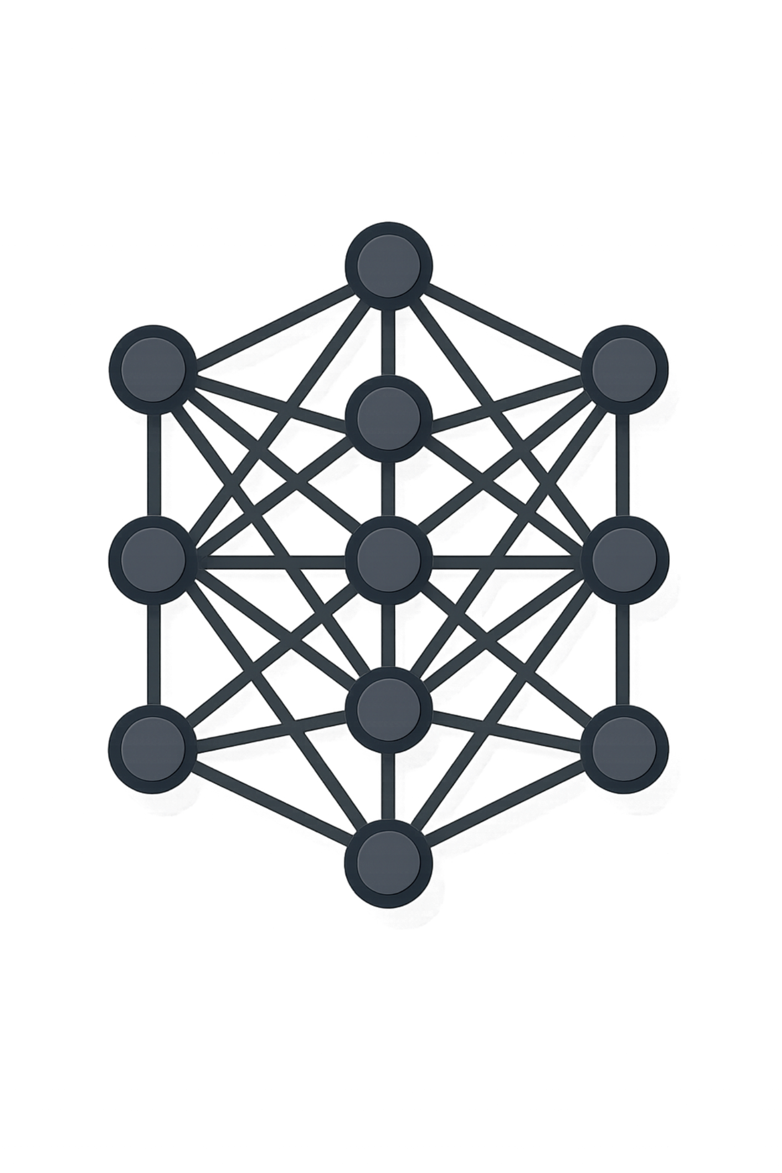



LLM Evaluation
How do we know if an AI system is actually working well?
User Question
Correct?
"Why did Brand A lose market share this quarter?"
Are the facts right?
LLM
Useful?
Processes the question and generates a free-form response
Does it answer the question?
Response
Grounded?
A fluent, confident-sounding answer — but is it actually good?
Supported by evidence?
Relevant?
On topic and complete?
With traditional ML, we usually know what the correct answer looks like. With LLMs — what does "correct" actually mean?

Slide 2


From ML Evaluation to LLM Evaluation
Start from what you already know — then see where LLMs break the mold.
TRADITIONAL ML
LLM
Label-Oriented Evaluation
Open-Ended Evaluation
01
Question: "Why did Brand A lose market share this quarter?"
Input → Model → Prediction
A
B
02
"Distribution declined."
"Distribution declined significantly, while competitor promotions increased."
Compare to Known Label
Actual: High Growth Prediction: High Growth ✓
03
C
D
Compute Metric
"The main issue was pricing."
"Brand A's market share fell from 18.2% to 15.9%."
Accuracy · Precision · Recall · F1 · ROC-AUC
A relatively clear evaluation target exists.
Which response is correct? It depends on what we mean by "good."
The challenge with LLMs is not just measuring correctness — it is defining what "good" means in the first place.

Slide 3
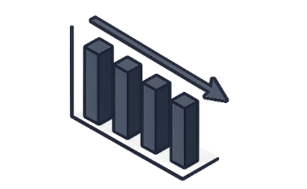


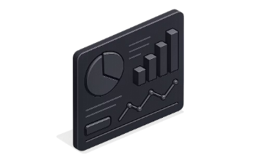
Why One Metric Is Not Enough
All four responses below are fluent and grammatically correct. Yet they vary dramatically in quality — and a single metric cannot capture that difference.
Response A
Response B
Response C
Response D
"Brand A's distribution fell from 82% to 71%."
✓ Correct fact △ Does not fully answer why
"Brand A lost share because its price increased by 18%."
⚠ Sounds plausible ✗ Unsupported by data
"Brand A currently has 15.9% market share."
✓ Correct fact ✗ Doesn't answer the question
"Brand A's share decline was mainly associated with lower distribution, while increased competitor promotions added pressure."
✓ Correct ✓ Grounded ✓ Relevant ✓ Complete
LLM quality is multidimensional. Correctness, Relevance, Groundedness, Completeness, Instruction Following, Clarity, Safety, and Domain-specific criteria all matter — often simultaneously.

Slide 4

Evaluating the Content: Correctness, Relevance & Groundedness
These three dimensions form the factual foundation of any good LLM response. Each can fail independently — even when the others look fine.
✓ Correctness
↔ Relevance
⚓ Groundedness
Are the factual claims right?
Data: Distribution = 82% → 71%
✓ "Distribution declined by 11 percentage points."
✗ "Distribution increased to 91%."
Checks whether the LLM stated something that is objectively true or false given the available data.
Does it answer the actual question?
Q: "Why did Brand A lose market share?"
✓ Factually correct: "Brand A has 15.9% market share."
✗ Does not answer why — it restates a fact without explaining the cause.
Relevance is about intent alignment, not just accuracy.
Are claims supported by evidence?
Data: Price = ₹95 → ₹96
✗ "Brand A lost share because its price increased by 18%." — Unsupported
✓ "Brand A's price remained relatively stable at ₹95–₹96." — Grounded
A response can be fluent and even technically correct while still failing another important quality dimension. These dimensions are independent failure modes.

Slide 5




Completeness, Instruction Following & Clarity
Beyond factual accuracy, well-formed LLM responses must cover the full picture, respect user constraints, and communicate clearly.
△ Completeness
Available drivers: Distribution ↓ Competitor promotions ↑ Price ≈ stable
Response: "Brand A lost share because distribution declined." — Correct ✓ Grounded ✓ but incomplete — it misses competitive pressure.
Better: "Share decline was mainly associated with lower distribution, while increased competitor promotions added pressure. Pricing remained relatively stable."
📋 Instruction Following
User asks: "Explain the decline in exactly 3 simple bullet points for a business audience."
✗ Long technical paragraph
✓ • Distribution fell from 82% to 71%.
• Competitors increased promotional activity.
• Pricing stayed relatively stable.
Facts correct ✓ Instructions followed ✓
💡 Clarity
✗ "Due to promotional competitive dynamics and distribution, despite pricing stability, share experienced deterioration..."
✓ "Brand A lost share mainly because distribution declined. Competitor promotions added pressure, while pricing remained stable."
Same facts — radically different readability.
Good LLM output is not only about factual correctness. A response must also be complete, follow user constraints, and communicate clearly to be genuinely useful.

Slide 6








What Does "Good" Actually Mean?
There is no single universal "LLM accuracy" metric. Evaluation dimensions should reflect what good behavior means for your specific application.
Correctness
Relevance
Are the factual claims accurate?
Does it answer the user's actual question?
Groundedness
Completeness
Are claims supported by available evidence?
Did it cover all important information?
Instruction Following
Clarity
Did it respect the requested format and constraints?
Is the response understandable and coherent?
Safety
Domain-Specific Criteria
Is the behavior appropriate and safe?
Does it satisfy the business requirement?

Slide 7

Who — or What — Evaluates the LLM?
No single evaluation method handles every case. In practice, real evaluation systems combine all three approaches based on the type of quality being measured.
Deterministic / Code-Based
Human Evaluation
LLM-as-a-Judge
Use when something can be objectively checked: valid JSON? Required fields present? Correct category? Schema followed?
Strengths: Fast · Cheap · Reproducible · Deterministic
"If it can reliably be checked with code, use code."
Domain experts assess correctness, usefulness, nuance, and business quality — judgment that requires real-world context.
Strengths: High-quality judgment · Domain expertise
Limitations: Slow · Expensive · Hard to scale · Raters may disagree
A separate LLM evaluates the response against defined criteria: correctness, relevance, groundedness, completeness, instruction following.
Flow: Question + Context + Candidate Answer + Criteria → Judge LLM → Score / Pass-Fail / Explanation
Real evaluation systems almost always combine all three. Use code for what code can check. Use humans for high-stakes judgment. Use LLM-as-a-Judge to scale the rest.

Slide 8



LLM-as-a-Judge: Worked Example
Rather than defining LLM-as-a-Judge abstractly, let's walk through what it actually looks like using the Brand A scenario.
Evaluation Input
Judge LLM Receives
Question: "Why did Brand A lose market share?"
Context:
· Share: 18.2% → 15.9%
· Distribution: 82% → 71%
· Price: ₹95 → ₹96
· Competitor promotions: Increased significantly
Candidate Answer:
"Brand A lost share mainly because distribution declined significantly."
Criterion: Groundedness — Are the claims supported by the provided context?
Question + Context + Candidate Answer + Evaluation Criterion
Judge LLM Outputs
Score: 5 / 5
"The answer correctly identifies the significant decline in distribution as a factor that is directly supported by the provided data."
The evaluated LLM generates the answer. A separate LLM evaluates it. This separation is what makes open-ended evaluation scalable.

Slide 9



Rubrics Make Evaluation Consistent
RUBRIC EXAMPLE: CORRECTNESS
5 — Fully Correct
4 — Mostly Correct
All factual claims are accurate and supported.
Correct overall with a minor factual issue.
3 — Partially Correct
2 — Major Problems
Contains an important error or omission.
Significant factual inaccuracies throughout.
1 — Fundamentally Wrong
Contradicts the available data or context entirely.
"Distribution fell significantly and pricing remained stable." → Fully supported → 5/5
"Distribution declined, but Brand A increased price by 20%." → One claim correct, one fabricated → Lower score
Without a rubric, asking a judge to score from 1–10 yields inconsistent, uninterpretable results. What exactly does a 7 mean?
Vague Criteria
Leads to inconsistent judgments
Clear Rubric
Enables repeatable, interpretable evaluation
Rubrics convert vague judgments into explicit, repeatable evaluation criteria — making scores comparable across runs, judges, and time.

Slide 10

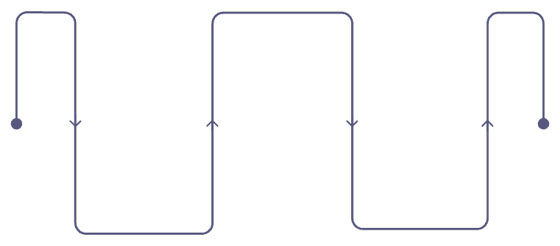

LLM Judge ≠ Ground Truth
If LLMs can make mistakes when generating answers, why would an LLM evaluating another LLM be perfect? It won't be — and that matters.
Misunderstanding the task
Judge Calibration
The judge may not correctly interpret the evaluation criterion.
LLM Judging
Judge labels the same sample
Verbosity and polish bias
Human Labeling
Agreement Audit
Judges often prefer longer, more confident-sounding answers even when they are wrong.
Experts label a trusted sample
Compare labels to find reliable areas
We must evaluate the evaluator. A judge that hasn't been calibrated against human judgment is just another unvalidated system.
Position bias
Order of presented options can influence judge scores.
Missing subtle domain errors
Price: ₹95 → ₹96. Judge may accept "Price increased significantly" — a domain expert would not.

Slide 11

Golden Datasets & Regression Testing
GOLDEN DATASET
REGRESSION TESTING
Just as traditional ML uses X_test + y_test, LLM evaluation uses a golden dataset — a trusted collection of representative cases that define expected behavior.
Prompt v7 → 91% pass
Prompt v8 → 95% pass
Brand A — Golden Case
Looks like an improvement — but dig deeper.
Q: "Why did Brand A lose share?"
Context: Share 18.2→15.9 · Dist 82→71 · Price 95→96 · Promos ↑
✓ Mention distribution decline
✓ May note competitive pressure
✓ Recognize pricing was stable
✗ Must NOT invent a large price increase
Dimension | v7 | v8 | Δ
Correctness | 91% | 96% | ↑ +5%
Relevance | 94% | 96% | ↑ +2%
Numerical Accuracy | 98% | 91% | ↓ −7%
Include: Normal cases · Hard cases · Edge cases · Previously discovered failures
Never look only at the overall score. Regression testing asks: did the change break something that previously worked?

Slide 12








The Complete LLM Evaluation Loop
Evaluation is not a one-time benchmark you run before deployment. It is a continuous improvement loop that feeds failures back into the system.
Define Desired Behavior & Evaluation Dimensions
Create Rubrics & Build Golden Dataset
Run LLM System
Evaluate: Code Checks + Human Review + LLM Judge
Score + Error Analysis
Improve Prompt / Model / System
Regression Test Against Golden Dataset
Deploy & Observe Production → Feed New Failures Back to Step 2
"Evaluation is not a one-time benchmark. It is a continuous improvement loop — and production failures are valuable data, not just incidents."

Slide 13
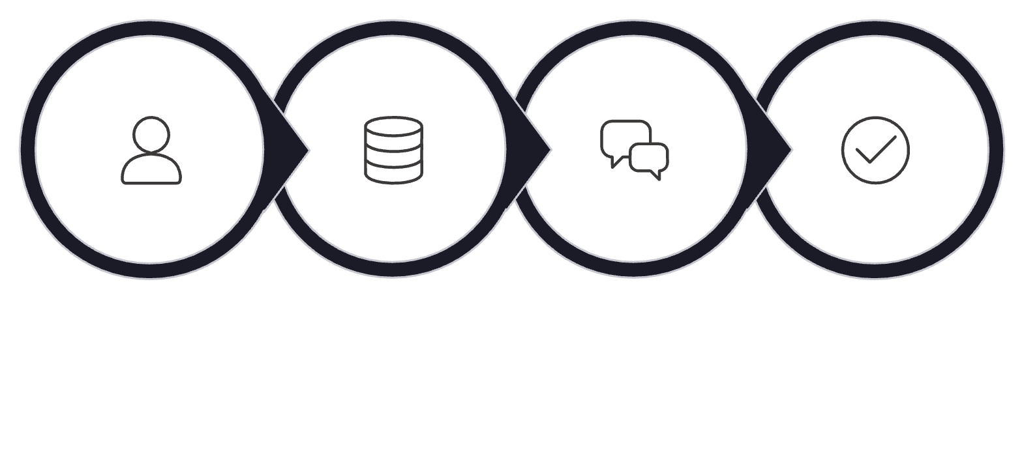
Glimpse: RAG Evaluation
In Retrieval-Augmented Generation systems, there are two places where things can go wrong — and they require different evaluation strategies.
Retrieval Evaluation
Did we retrieve the right information?
Recall@K — Were relevant docs returned?
Precision@K — Were results actually useful?
Hit Rate · MRR · NDCG
User Query
Retriever
LLM Response
Evaluation
Generation Evaluation
"Did the LLM fail — or did retrieval fail?" Without separate evaluation layers, you cannot tell.
Was the final answer good given what was retrieved?
Correct? Relevant? Grounded?
Complete? Citation-accurate?
RAG Evaluation = Retrieval Quality + LLM Response Quality

Slide 14





Glimpse: Agentic Evaluation
Agents introduce a new problem: the final answer may look excellent even when the agent made an error during execution. Evaluating only the output is not enough.
USER REQUEST
AGENT EVALUATION DIMENSIONS
"Compare Brand A with its top competitor this quarter, calculate the share gap, identify the main performance drivers, and summarize in 3 bullets."
Task Success
Did the agent complete the overall objective correctly?
⚠ Agent Calculation Error
Tool Selection & Arguments
Brand A = 15.9% · Brand B = 19.2%
Agent calculates: 19.2 − 15.9 = 2.3 ✗
Correct answer: 3.3 percentage points
The final summary may still read perfectly — hiding the arithmetic mistake.
Did the agent call the right tools with the right inputs?
Trajectory / Workflow
Was the sequence of actions efficient and correct?
Error Recovery
Did the agent detect and correct its own mistakes?
Agent Evaluation = LLM Response Quality + Action / Tool / Workflow Quality

Slide 15



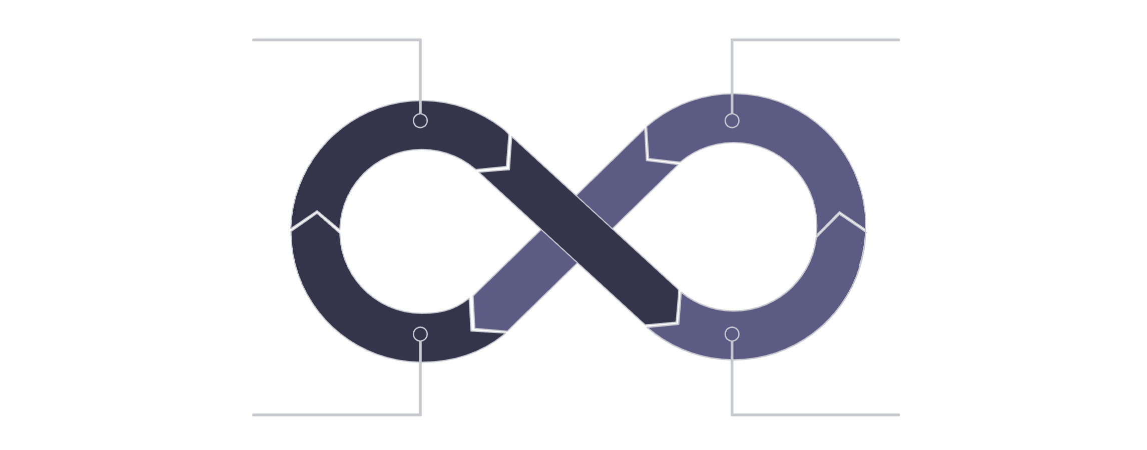
Final Mental Model
LLM Evaluation — What? With What? Against What?
What Are We Evaluating?
With What?
Against What?
Correctness · Relevance · Groundedness · Completeness · Instruction Following · Clarity · Safety · Domain-Specific Criteria
Deterministic Code Checks · Human Evaluators · LLM-as-a-Judge
Combine all three — each covers what the others cannot.
Expected Values · Reference Answers · Rubrics · Golden Dataset · Production Failure Log
Evaluate Outputs
Find Failures
Regression Test
Improve System
"LLM evaluation is not about finding one perfect accuracy metric."
It is about defining what "good" means, measuring it consistently, finding where the system fails, and ensuring that improvements do not break what already works.

